Slide 5
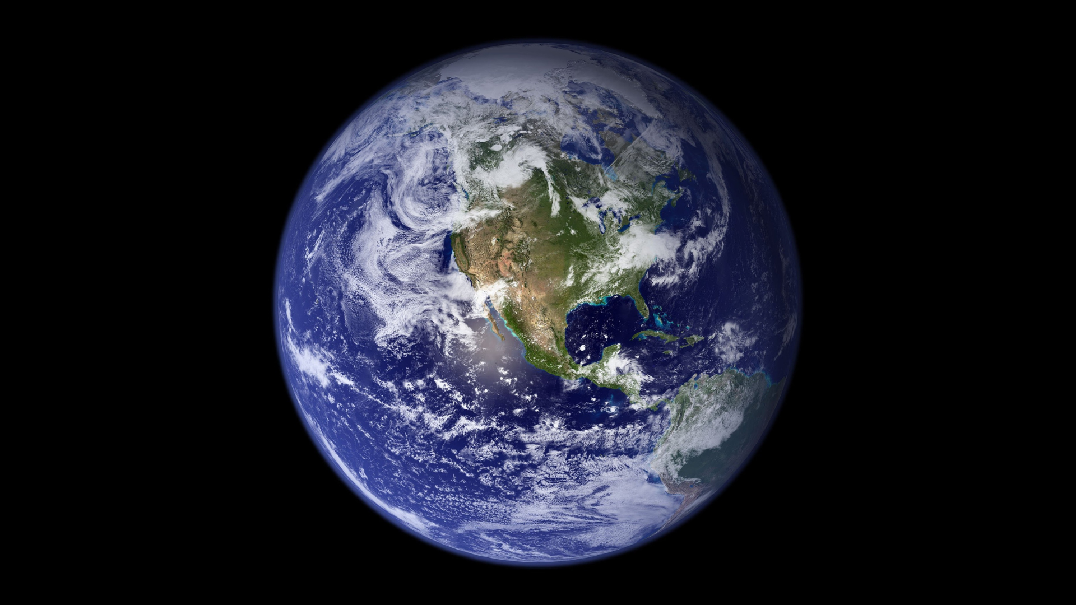

Slide 6
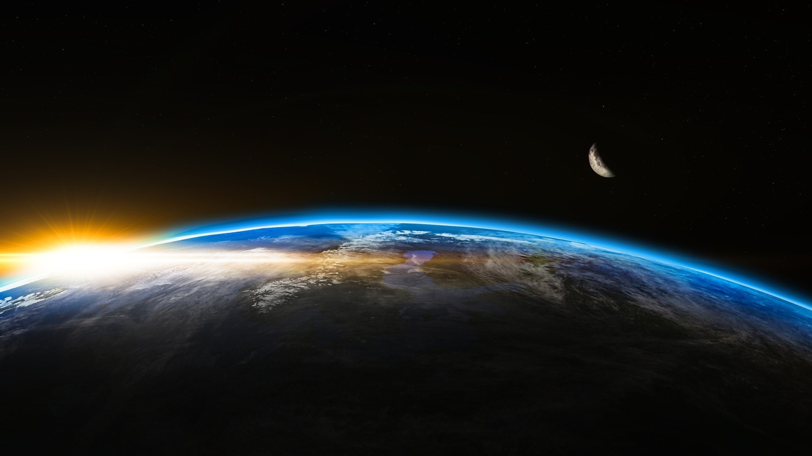

Slide 7
O Lord, my God, when I in awesome wonder (StF 82)
O Lord my God! When I in awesome wonder
consider all the works thy hand hath made,
I see the stars, I hear the mighty thunder,
thy power throughout the universe displayed;
Then sings my soul, my Saviour God, to thee,
how great thou art, how great thou art!
Then sings my soul, my Saviour God, to thee,
how great thou art, how great thou art!

Slide 8
When through the woods and forest glades I wander
and hear the birds sing sweetly in the trees;
when I look down from lofty mountain grandeur
and hear the brook and feel the gentle breeze:
Then sings my soul, my Saviour God, to thee,
how great thou art, how great thou art!
Then sings my soul, my Saviour God, to thee,
how great thou art, how great thou art!

Slide 9
And when I think that God, his Son not sparing,
sent him to die – I scarce can take it in
that on the cross, my burden gladly bearing,
he bled and died to take away my sin:
Then sings my soul, my Saviour God, to thee,
how great thou art, how great thou art!
Then sings my soul, my Saviour God, to thee,
how great thou art, how great thou art!

Slide 10
When Christ shall come with shouts of acclamation
and take me home – what joy shall fill my heart!
Then shall I bow in humble adoration
and there proclaim, ‘my God, how great thou art!’
Then sings my soul, my Saviour God, to thee,
how great thou art, how great thou art!
Then sings my soul, my Saviour God, to thee,
how great thou art, how great thou art!

Slide 12
All creatures of our God and King (StF 99)
All creatures worship God most high,
lift up your voice in earth and sky,
alleluia, alleluia!
Thou burning sun with golden beam,
thou silver moon with softer gleam,
O sing ye, O sing ye, alleluia, alleluia, alleluia!

Slide 13
Thou rushing wind that art so strong,
ye clouds that sail in heav’n along,
alleluia, alleluia!
Thou rising morn in praise rejoice,
ye lights of evening, find a voice,
O sing ye, O sing ye, alleluia, alleluia, alleluia!

Slide 14
Thou flowing water, pure and clear,
make music for thy God to hear,
alleluia, alleluia!
Thou fire so masterful and bright,
that givest all both warmth and light,
O sing ye, O sing ye, alleluia, alleluia, alleluia!

Slide 15
Dear mother earth, who day by day,
unfoldest blessings on our way,
alleluia, alleluia!
The flow’rs and fruits that in thee grow,
let them God’s glory also show,
O sing ye, O sing ye, alleluia, alleluia, alleluia!

Slide 16
And ev’ryone, with tender heart,
forgiving others, take your part,
alleluia, alleluia!
Ye who long pain and sorrow bear,
sing praise and cast on God your care,
O sing ye, O sing ye, alleluia, alleluia, alleluia!

Slide 17
And thou, most kind and gentle death,
waiting to hush our final breath,
alleluia, alleluia!
Thou leadest home the child of God,
as Christ before that way hath trod,
O sing ye, O sing ye, alleluia, alleluia, alleluia!

Slide 18
Let all things their Creator bless,
and worship God in humbleness,
alleluia, alleluia!
To God all thanks and praise belong!
Join in the everlasting song:
O sing ye, O sing ye, alleluia, alleluia, alleluia!

Slide 19
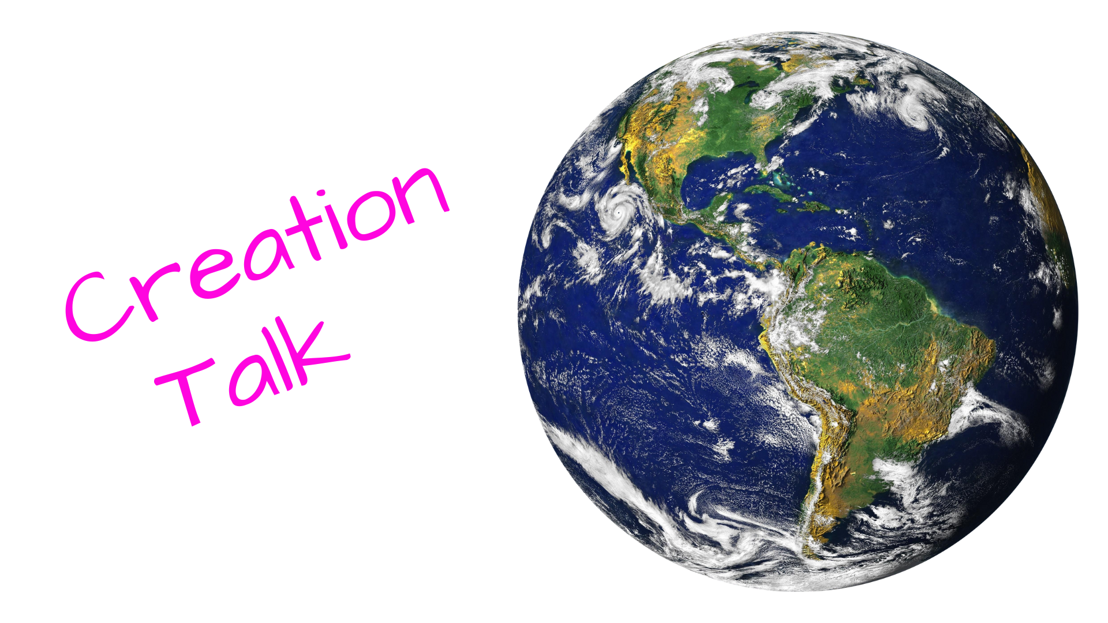

Slide 21
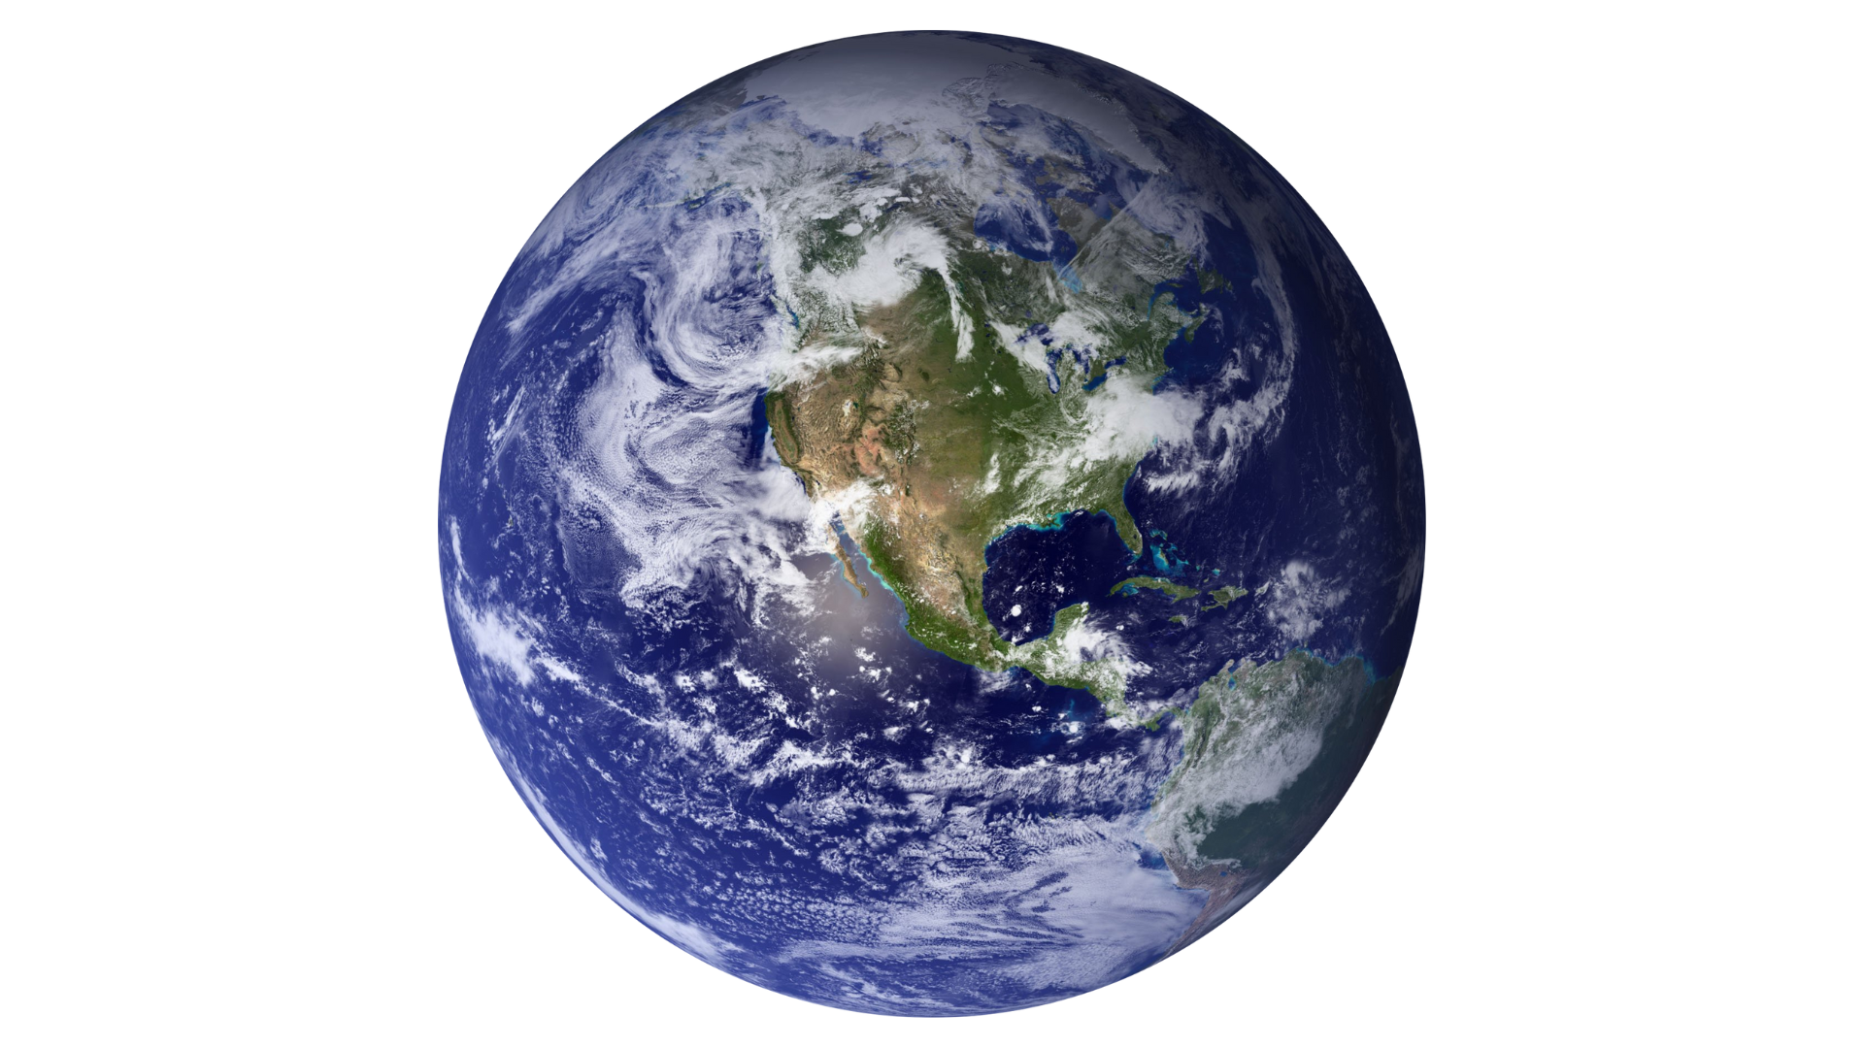

Slide 26
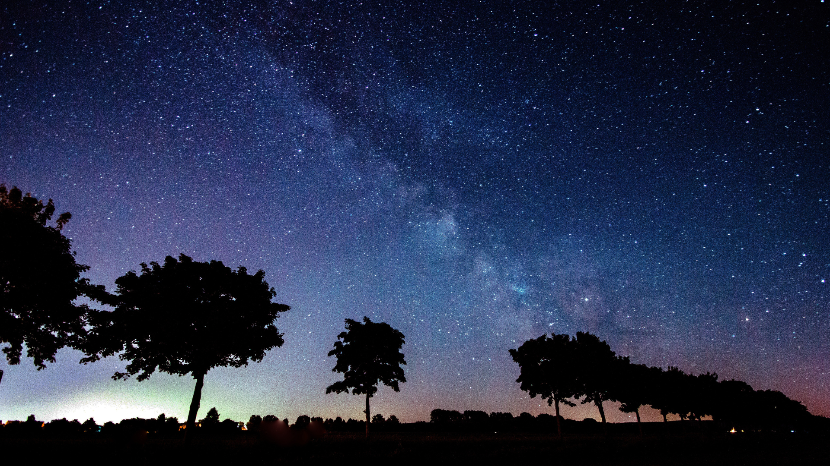

Slide 28
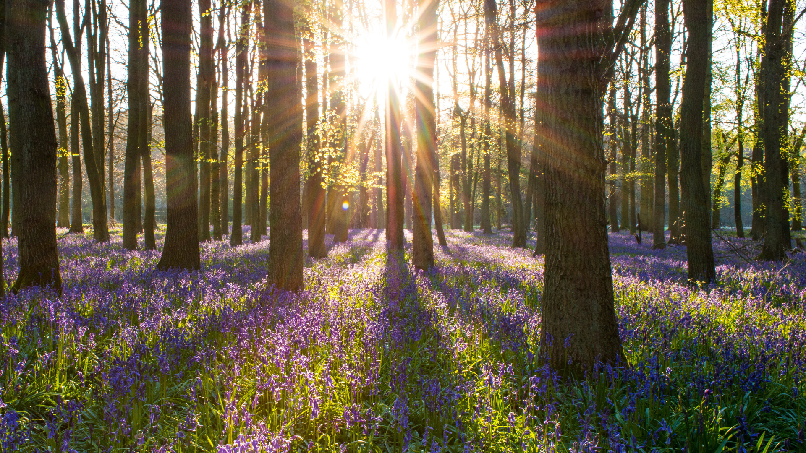

Slide 29
For the beauty of the earth earth (StF 102ii)
For the beauty of the earth,
for the glory of the skies,
for the love which from our birth
over and around us lies;
Lord of all, to thee we raise
this our hymn of grateful praise.

Slide 30
For the beauty of each hour
of the day and of the night,
hill and vale, and tree and flower,
sun and moon, and stars of light;
Lord of all, to thee we raise
this our hymn of grateful praise.

Slide 31
For the joy of ear and eye,
for the heart and mind's delight,
for the mystic harmony,
linking sense to sound and sight;
Lord of all, to thee we raise
this our hymn of grateful praise.

Slide 32
For the joy of human love,
brother, sister, parent, child,
friends on earth and friends above,
for all gentle thoughts and mild;
Lord of all, to thee we raise
this our hymn of grateful praise.

Slide 33
For thy church, that evermore
lifteth holy hands above,
offering up on every shore
her pure sacrifice of love;
Lord of all, to thee we raise
this our hymn of grateful praise.

Slide 34
For thyself, best Gift Divine,
to the world so freely given,
for that great, great love of thine,
peace on earth, and joy in heaven:
Lord of all, to thee we raise
this our hymn of grateful praise.

Slide 36
All things bright and beautiful (StF 100i)
All things bright and beautiful,
all creatures great and small,
all things wise and wonderful,
the Lord God made them all

Slide 37
Each little flow’r that opens,
each little bird that sings,
God made their glowing colors,
God made their tiny wings
All things bright and beautiful,
all creatures great and small,
all things wise and wonderful,
the Lord God made them all

Slide 38
The purple-headed mountain,
the river running by,
the sunset, and the morning
that brightens up the sky;
All things bright and beautiful,
all creatures great and small,
all things wise and wonderful,
the Lord God made them all

Slide 39
The cold wind in the winter,
the pleasant summer sun,
the ripe fruits in the garden,
God made them, ev’ry one
All things bright and beautiful,
all creatures great and small,
all things wise and wonderful,
the Lord God made them all

Slide 40
God gave us eyes to see them,
and lips that we might tell
how great is God Almighty,
who has made all things well
All things bright and beautiful,
all creatures great and small,
all things wise and wonderful,
the Lord God made them all

Slide 42
